Slide 1
Impact Metrics in Scholarly Publications - Do they Encompass the Impact of Science?
Sam T Mathew
Researcher and Medical communication strategist
Bangalore, India

Slide 2
Disclaimer
Employee of GlaxoSmithKiline Pharmaceuticals
Responsible honorary editorial positions at
Journal of current drug delivery
Indian Journal of novel drug delivery systems
Science Editing
Trends in Scholarly Publishing
Medical writing and publication consultant/trainer
This presentation was prepared and accomplished by the presenter in his personal capacity.
The opinions expressed in this presentation are the author's own and do not reflect the view of the employer
The content, images and logos used in this presentation are only for general information and educational purpose. The logos and content provided here belong to their respective owners

Slide 3
Agenda
1
2
3
Why to perform research
or publish?
What is impactful
research?
How to measure
research impact?
4
5
6
Metrices for
research impact?
Bibliometrics vs Altmetrics
Conclusion

Slide 4
Why to perform research or publish?
Perspectives of authors
Improved funding
Ego
Career prospects
13%
20%
9%
Other
5%
54%
Dissemination
Patent protection
4%
Bryan Coles (ed.) The STM Information System in the UK, BL Report 6123, Royal Society, BL, ALPSP, 1993

Slide 5
What is impactful research?
Standard definitions
National Institutes of Health
The project's ability to have a long-term, substantial impact on the scientific field(s) involved.
National Science Foundation
The ability to help community and help achieve desirable societal results.
UK Research Excellence Framework
Beyond academics, an impact or change/benefit to the economy, society, culture, public policy or services, health, the environment, or standard of living.
Australian Research Council
The impact of research on society, the environment, the economy, and culture in addition to its impact on academic research.
Substantial and long lasting effect on the science and society; Well being of the people; Benefits to the economy; Improvements in public policy

Slide 6
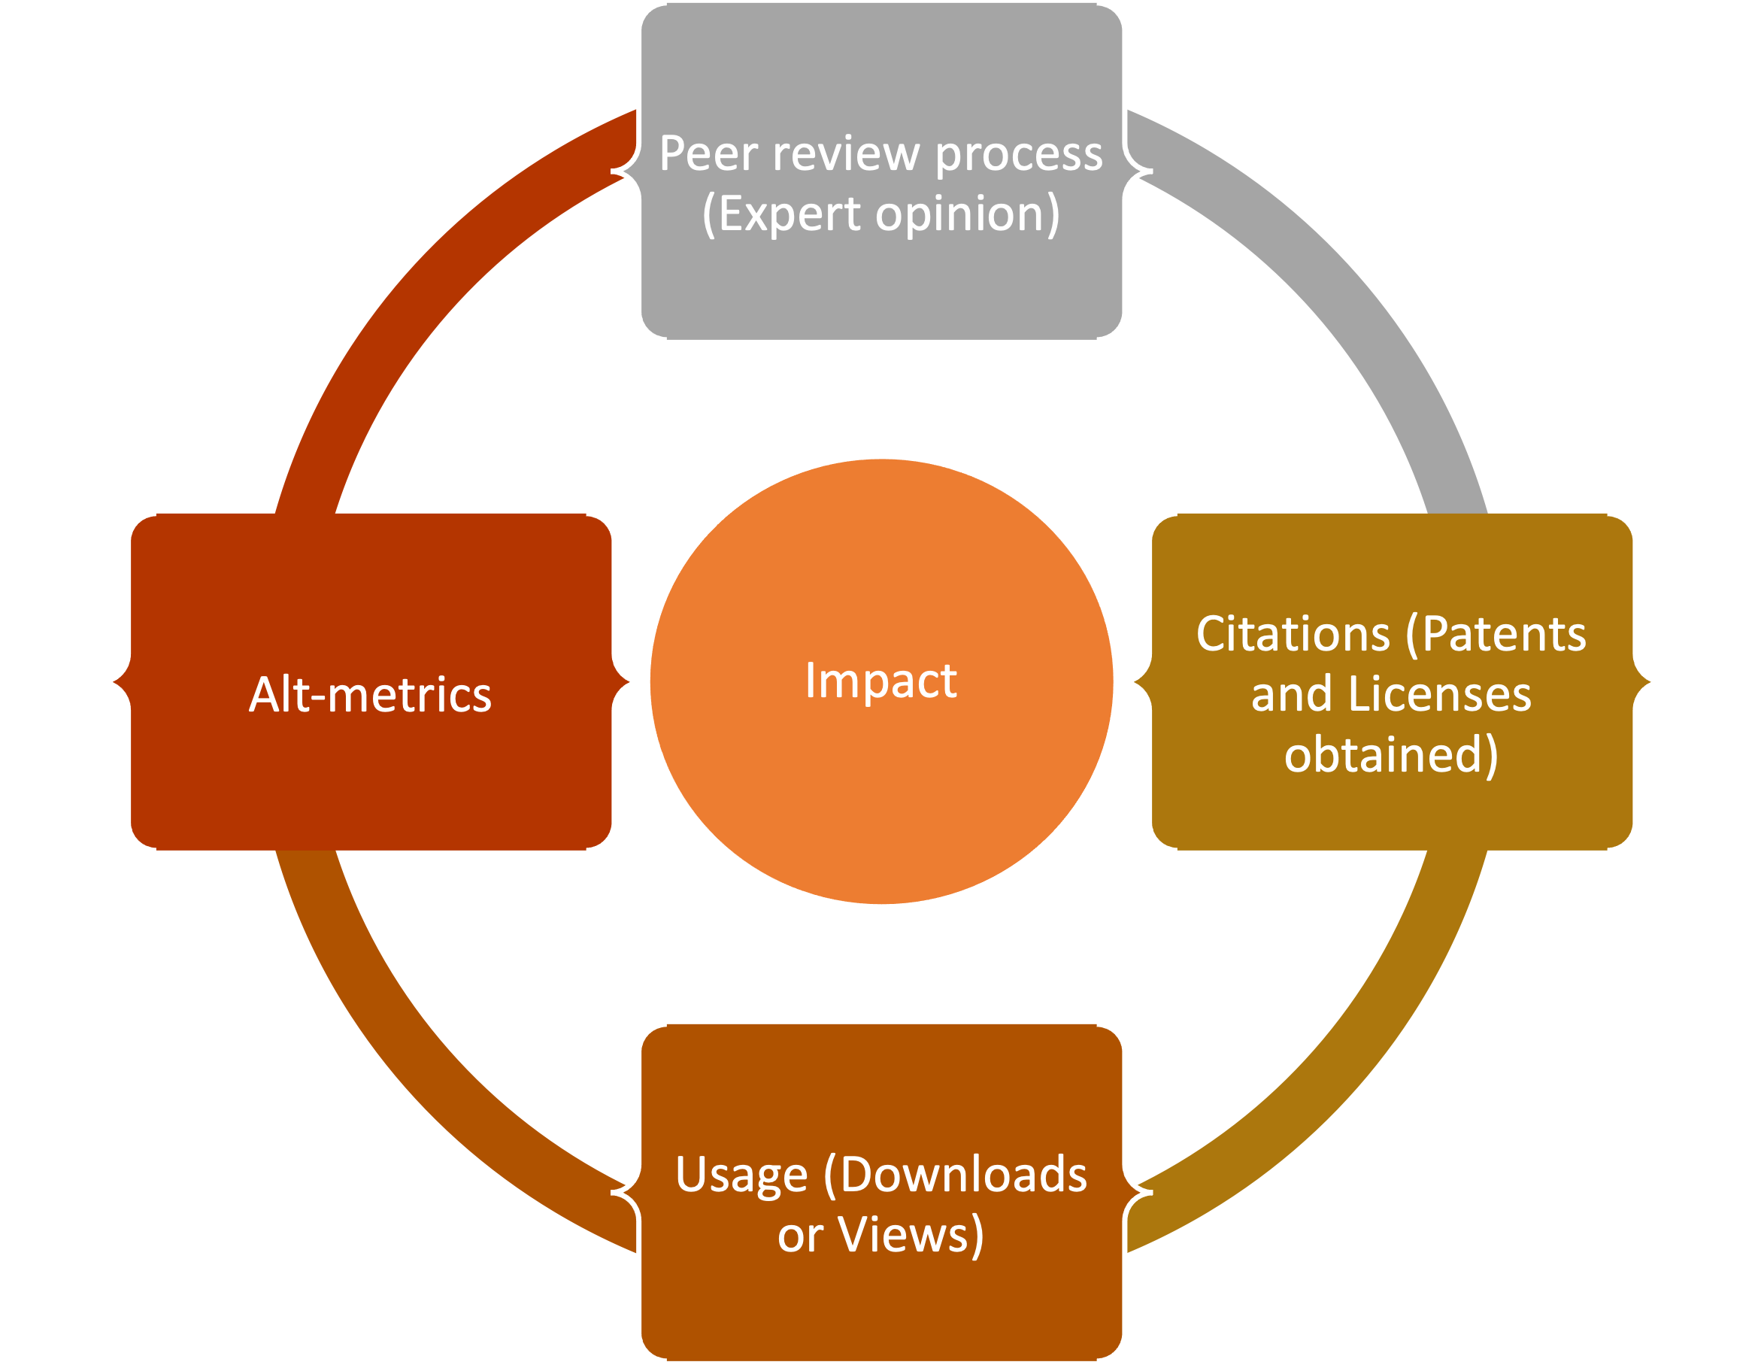
How to measure research impact?

Slide 7
Impact of published research
Available metrics
Article or Author-level metrics
Article citation tracker
H-index
I10 index
G-index
E-index
Author profiles
Scholarometer
Publish or perish
Altmetric
PlumX Metric
Journal-level metrics
Journal Impact factor (JIF)
Journal Citation Reports (JCR)
Eigenfactor score (ES)
H5-index
CiteScore (CS)
Source-Normalised Impact per paper (SNIP)
Acceptance rate
SCImago journal rank (SJR)

Slide 8
To search topic and cited references
Web of Science
Focus: English language, STM journals
Inaccurate citations, misspelt author names
Journal coverage is limited to US, UK, Netherlands
Citation statistics of items within Google Scholar
Article citation trackers and RCR
Wide range of content, extensive but not exhaustive
Citation data for journal and author
Inconsistent search results, forcing the researcher to chose appropriate result
Transparency: Content updated date, criteria to be considered scholarly are missing
Google Scholar
Bibliographic database
Wide range of study area
Citation tracking is only possible from 1996
Scopus
By NIH
RCR = article citation rate, or the average number of citations an article obtains annually / predicted citation rate, or the citation rate of NIH-funded papers in the same year and academic field
Relative Citation Ratio (RCR)

Slide 9
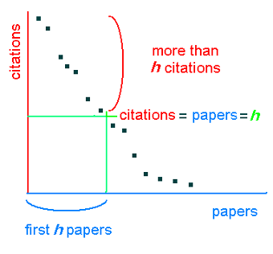
H-Index
Quantifying research output by assessing researcher productivity and impact
What is it?
By J.E. Hirsch in 2005
Calculated by counting the number of publications for which an author has been cited by other authors at least that same number of times.
To assess the quality of the study produced by a team of researchers, an author, an organization, a publication etc
Eliminates outlier publications that might distort the scientist’s actual impact
Published by WoS, Google Scholar, Scopus
Objective characterization of a scientist’s output and helps to chose rewards, funding and career promotions
For a researcher with 20 yr experience: h-index of 20 is good, 40 is outstanding, and 60 is truly exceptional
Limitations
Not useful for early career scholar and scholars with few citations.
Self citation manipulation. Review articles are cited more than the original research
Lack of sensitivity to highly cited papers beyond the ‘h’ value
It does not consider the number of authors on a paper
Researchers with common names – difficult to get their whole list of publications
Varied citation habits among different fields of research
Some sources are subscription based; Scores varies based on the source
Notes:
University of California San Diego. PUBLISHED IN PNAS
Hirsch shows that successful scientists do, indeed, have high h-indices: 84% of Nobel prize winners in physics, for example, had an h-index of at least 30.

Slide 10
G, E and I10 indices
G-Index: Introduced as an improvement to H-index
By Egghe Leo in 2006
It considers highly cited papers beyond the ‘h-value’ of the h-Index. Helpful for comparing researchers with identical ‘h-index’
Group of articles ranked in decreasing order of the number of citations. The g-index is the largest number such that the top g articles received at least g² citations.
g-index gives more weight to highly-cited articles (Performance of author's top articles).
Available at Publish or Perish. Superiority is still disputable
I10-Index
E-Index: to complement H-Index
By Google scholar in 2011 to rank author influence
I10-Index=number of publications with at least 10 citations
Free, simple to comprehend easy to calculate
By Chun-Ting Zhang in 2009
Focuses highly cited papers
Helps in better evaluation of researchers with different total citations but similar ‘h-index’

Slide 11
Author profiles, Scholarometer and PageRank Index
Author Profiles
PageRank index (π)
01
With Web 2.0 online author profiles create identity of authors
Scopus author IDs, ResearcherID, and Open Researcher and Contributor Identification (ORCID)
Utilizes Google's PageRank algorithm
Weighted scores are assigned based on the PageRank score of the website citing the research
Helps differentiate early career researchers and tenured researchers
Do not neglect researchers with few publications – innovative publications are included
Difficult calculations
Values are heavily reliant on the visibility and marketing of articles
02
Scholarometer (h_{s})
A social platform to facilitate citation analysis introduced by Indiana University (Kaur et al, 2012 & 2013)
Works with a browser extension which is integrated with Google scholar
To see the score, one must tag the author with a field. Fields are derived from WoS.
03
2

Slide 12
Impact factor (IF) and Journal Citation Reports (JCR)
What is it?
Eugene Garfield introduced the concept in Science in 1955
Measure of the frequency with which the average article in a journal has been cited in a particular year.
JCR provides (from 1975) quantitative tools for ranking, evaluating, categorizing, and comparing journals
IF provides quantitative evidence for editors and publishers for positioning their journals in relation to the competition
2 y and 5 y IF
Limitations
By Clarivate only for journals indexed in WoS
Statistical validity: Mean or Median
Just represent citations to articles published. Not a measure of quality of process and content
Journal publishing more review articles gain high IF
Only for journals with 3 y of publication history
Controversy with year of IF publication; IF is calculated before all publications are indexed
May be impacted by field-dependent factors
Includes only research articles and reviews
Process of exclusion is sometimes complex or not transparent

Slide 13
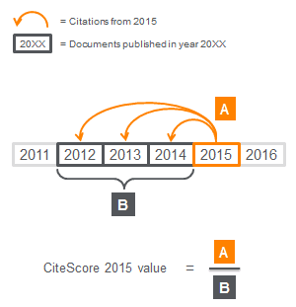
CiteScore (CS)
Number of citations received by a journal in one year to documents published in the three previous years, divided by the number of documents indexed in Scopus published in those same three years.
Include all document types
The three-year citation window
CiteScore tracker provides live impact
CiteScore is available as soon as they are first indexed in Scopus
More transparent: Automatically covers all applicable serials, no complex process or unclear omissions
Encompass all limitations of bibliographic or Citation impact
Elsevier’s proprietary through Scopus

Slide 14
Source normalized impact per paper (SNIP)
Introduced by Prof Henk Moed at the Centre for Science and Technology Studies (CTWS), University of Leiden
Same principle as CiteScore but a metric that accounts for field-specific differences in citation practices by comparing each journal’s citations per publication with the citation potential of its field.
Measures the impact of a paper within a subject field
Helps authors to identify which journals are performing best within their subject field
By Scopus
SNIP = Average number of citations received in a particular year by papers published in the journal during the three preceding years / Database Citation Potential

Slide 15
The SCImago Journal & Country Rank (SJR) and Eigen factor score (ES)
The SCImago Journal & Country Rank
Free journal metric uses algorithm similar to PageRank
by Felix de Moya (the University of Granada in Spain) based on Scopus data
Based on the assumption that "all citations are not created equal."
SJR measure the scientific influence of journals by
Number of citations and
Prestige of the journals from which the citations come from
The SJR assigns different values to citations depending on the importance of the journals where they come from
Classifies journals into Q1 to Q4
Opportunity to select Open access, WoS and SciElo only journals
Eigen factor score (ES)
by Professor Carl Bergstrom and his laboratory at University of Washington in 2008
Number of times publications from a journal published over the preceding five years were cited in the JCR year
WoS citation data
Counts citations to journals in both the sciences and social sciences.
Eliminates self-citations

Slide 16
Internet and digitalization: Evolution of impact metrics
Bibliometrics
Altmetrics
Bibliometrics
Altmetrics
With the establishment of the Science Citation Index (SCI), the subject of bibliometrics was formed
Allan Pritchard used this term first time in a work that was released in 1969
Assumption: Citations are affirmative response to a scholarly work and are a good indicators for quantitative assessment of quality research
Conventional citation-based measures uses data from various sources
Multiple indices. Each is created by a separate firm and uses citation data
Areas of concern
Inter field/subject disparities I Obtaining a citation takes years
Can’t apply to scientists at different stages of career
Methodological aspects of calculation
Self citation and manipulation of citation I Difficult to retrieve data for scientists whose has common names
Inconsistency in the type of articles included I Difficult/nontransparent calculations and criteria
Language disparity I Waiting period to include for assessment
Some are subscription based I WoS, Scopus and GS are major databases
Introduced in 2010
Different categories: Shares, downloads, comments, customizations, and social usage data.
Further, set aside for future reading, discussed in research world, recommended to someone
Two web platforms involved:
content platforms where research findings are uploaded
social media where research is shared for information exchange, saving, or analysis (Twitter, Facebook, Mendeley, Reddit, F1000)
Faster and reaches larger audiences
Receives instantaneous feedback
Stratifies data of group of readers/users
Areas of concern
In developing stage, no established methods to measure
More susceptible to manipulations
Limited lasting impact

Slide 17
PlumX Metrics
From Plum Analytics, with EBSCO from 2014, with Elsevier from 2017
Sheds light on how individuals engage with certain research outputs in the online environment
All types of scholarly research output
Data is broken down into five categories: utilization, captures, references, social networks, and citations.
Citations: citation indexes, patent citations, clinical citations, policy citations
Utilization: clicks, downloads, views, library holdings, video plays
Captures: bookmarks, code forks, favorites, readers, watchers
Mentions: blog posts, comments, reviews, Wikipedia references, news media
Social media: shares, likes, comments, tweets

Slide 18
Conclusions
Understanding the pros and cons, the stakeholders should interpret the ratings
Current impact metrices are far from ideal
Need of commercially independent or collaborated indices with editorial or Govt bodies
Majority of the current metrices are part of commercial institutions
Metrics-only approach will not capture broader societal impacts on economic, technologic and innovative advancements
Impact of science and research efforts are beyond just the publications
Altmetrics is promising. Innovative approaches to amalgamate altmetrics, bibliometrics and societal impact should be considered
New instruments to access the impact of research is needed

Slide 19
Any questions?
You can contact me at
Sam.t.mathew@outlook.com
+91 9740184848

